Slide 1

Advertisement Sale Prediction From Existing Customer - Logistic Regression

Slide 2
Flow Diagram
*Importing Libraries*
*Evaluating *
*Choose Dataset File From Local Directory*
*Prediction for all Test Data*
*Load the Dataset*
*Predicting*
*Summarize Dataset*
* Training*
* Feature Scaling*
* Feature Scaling*
*Splitting Dataset into Train & Test*
*Segregate
Dataset into X & Y*

Slide 3

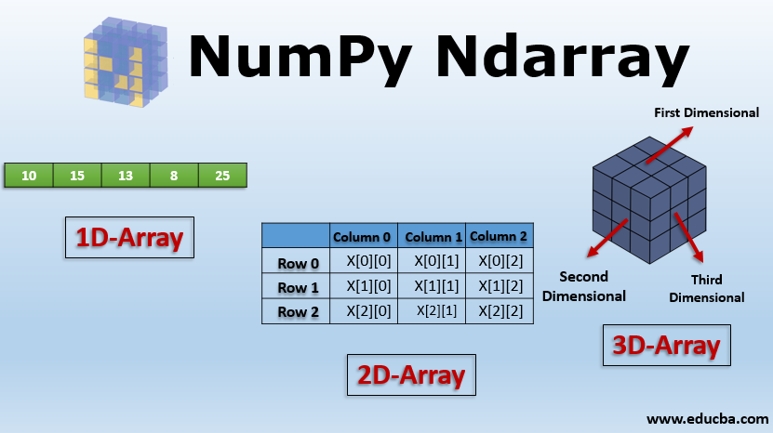
*Importing Libraries*
import pandas as pd #useful for loading the dataset
import numpy as np #to perform array

Slide 4
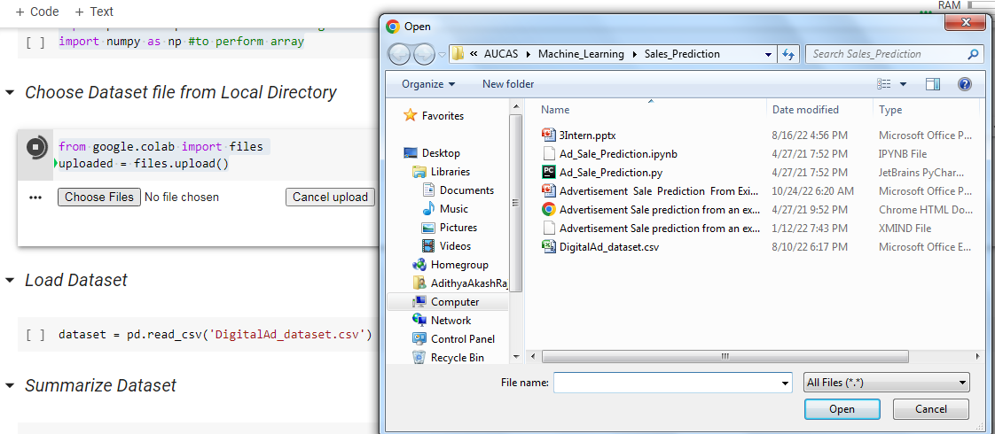
*Choose Dataset File From Local Directory*
from google.colab import files
uploaded = files.upload()

Slide 5
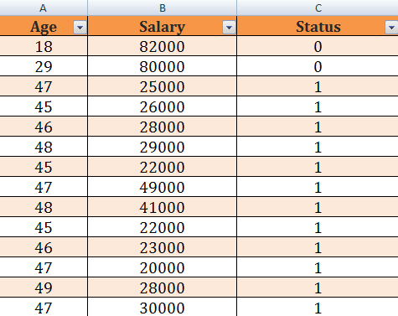
*Load the Dataset*
dataset = pd.read_csv('DigitalAd_dataset.csv')

Slide 6
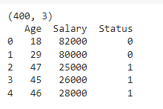
*Summarize Dataset*
print(dataset.shape)
print(dataset.head(5))

Slide 7
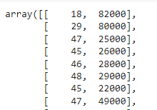
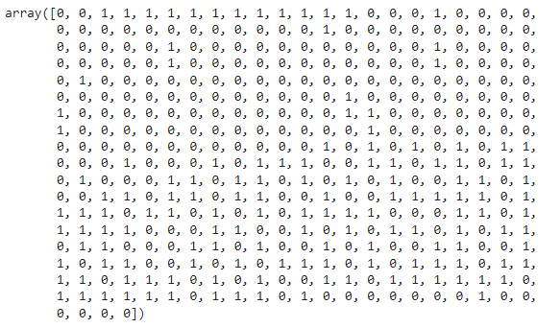
*Segregate Dataset into X & Y*
X = dataset.iloc[:, :-1].values
X
Y = dataset.iloc[:, -1].values
Y

Slide 8
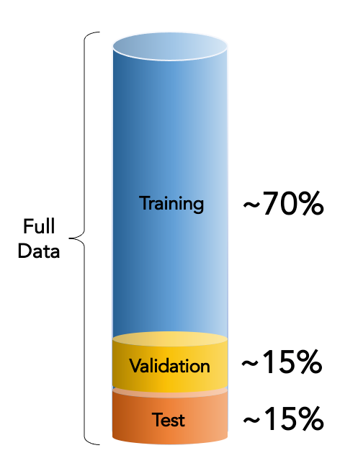
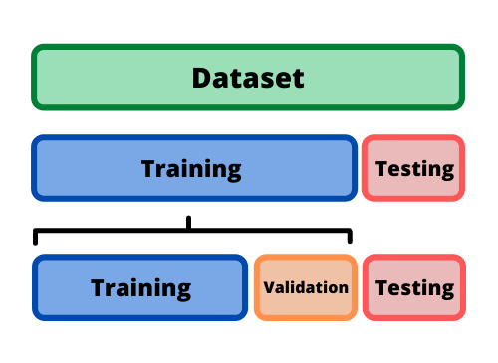
*Splitting Dataset into Train & Test*
from sklearn.model_selection import train_test_split
X_train, X_test, y_train, y_test = train_test_split(X, Y, test_size = 0.25, random_state = 0)

Slide 9
*Splitting Dataset into Train & Test*
from sklearn.preprocessing import StandardScaler
sc = StandardScaler()
X_train = sc.fit_transform(X_train)
X_test = sc.transform(X_test)
we scale our data to make all the features contribute equally to the result.
Fit_Transform - fit method is calculating the mean and variance of each of the features present in our data.
Transform - Transform method is transforming all the features using the respective mean and variance.
We want our test data to be a completely new and a surprise set for our model.

Slide 10
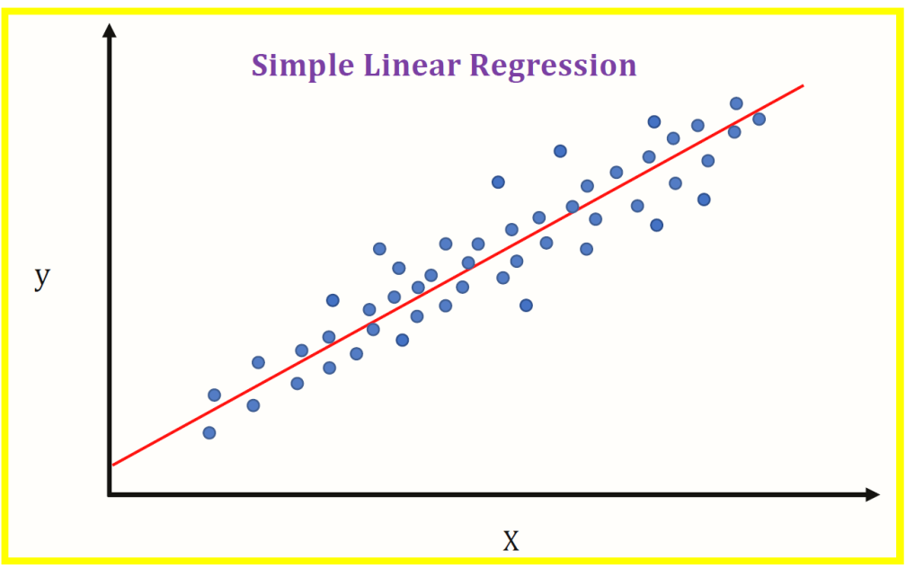
*Linear Regression*
Assume that there is only one independent variable x. if the relationship between x (independent variable) and y (dependent variable or output variable) is modeled by the relation
y=a+bx

Slide 11
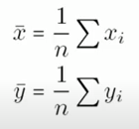



find the value of a and b
Find the mean and covariance
Means of x and y are given by
Now the value of a and b can be computed using the following formulas
The variance of x given by
The covariance of x and y denoted by cov(x,y) is defined as

Slide 12
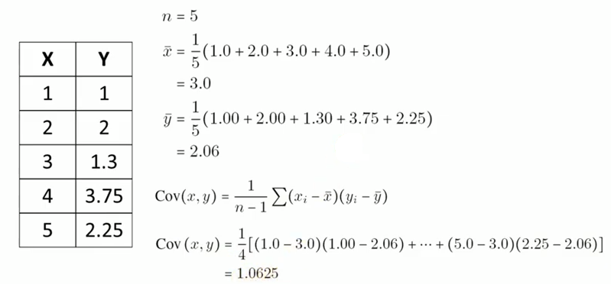
Conti…

Slide 13
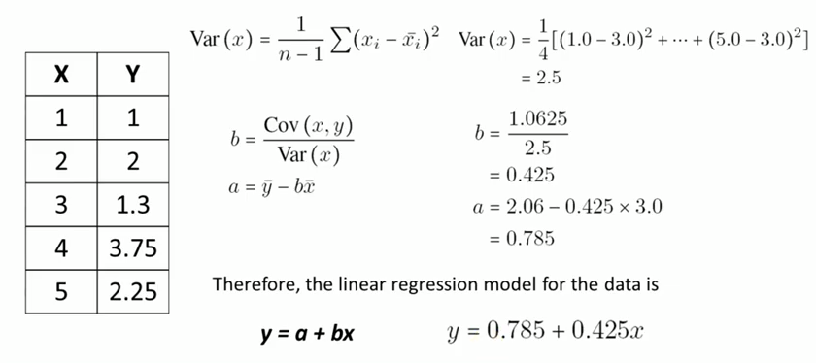
Conti…

